Slide 1

AI Engineer Agentic Track
The Complete
Agent & MCP
Course
Week 5
Day 2

Slide 2
Week 6: MCP
Agentic
Architecture
and MCP
Building an
MCP Server
and Client
Multiple Local
and Remote
MCP servers
Project 8: AI
Equity Traders
Project 8: AI
Equity Traders
In Action
Week 5: Agent Frameworks
Google ADK and A2A
Strands and Pydantic AI
MAF and
Agno
Mastra
Project 7:
Agent
Loop
Week 4: LangGraph
LangChain Core
LangGraph
LangChain
create_agent
Deep Agents
Project 6:
Sidekick
Week 3: CrewAI
Understand
Crew AI
Concepts
Build a Crew
Agent
Project 4: Stock
Picker
Project 5:
Developer
Agent
Project 5:
Engineering
Team
Week 2: OpenAI Agents SDK
Understand
OpenAI Agents
SDK concepts
Project 2: an
SDR
Tools vs Agents
Guardrails
Project 3: Deep
Research
Project 3: Deep
Research app
Week 1: Foundations
Make an
Agentic
Workflow
Agents and
Agentic
Patterns
Orchestrating
LLMs
Autonomy and
Tools
Project 1:
Your personal
career agent

Slide 3
Introducing AWS Strands
Very lightweight
What it is AWS's lightweight model-driven agent SDK, open source under Apache 2.0
Standout trait write tools once, swap the backing provider in a single line
Bedrock first But we swap in gpt-5.4-mini via OpenAIModel
Maturity GA since July 2025, Python SDK 1.43.0 with weekly releases

Slide 4





AWS Strands: key features
What stands out
Tools a typed function plus a docstring under @tool, schema derived for you
MCP MCPClient passed into Agent(tools=[fs]), managed lifecycle handles it
Agent loop hand it a task and tools, the model plans, calls, observes, repeats
Provider swap one OpenAIModel line points at OpenAI, Ollama, Bedrock or any endpoint
Observability stream_async emits every tool call, plus OpenTelemetry traces

Slide 5
AWS Strands: the trade-offs
Advantages, downsides
Any provider the one-line model swap is cleaner here than almost anywhere else
Lightest loop a working agent with a tool is three or four lines, no graph wiring
First-class MCP MCP and A2A built on the official packages, so the idioms transfer
Bedrock default a bare Agent() expects AWS credentials, so always pass the model
Fast cadence roughly weekly releases drift the blog posts, so pinning is essential

Slide 6
Introducing Pydantic AI
The framework that inspired OpenAI Agents SDK
What it is the agent framework from the team behind the Pydantic library
Standout trait end-to-end type safety, you declare shapes and it validates the flow
We use Python with gpt-5.4-mini, string openai-chat:gpt-5.4-mini
Maturity Beta for 1 in 2024, pinned at v1.107.0 with a v2 beta open

Slide 7

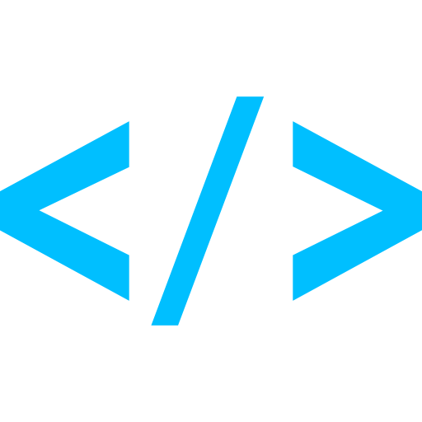
Pydantic AI: key features
What stands out
Tools @agent.tool_plain or @agent.tool, schema from hints and docstrings
MCP MCPToolset via toolsets=[...], opened with async with agent
Agent loop one await agent.run() runs the whole tool loop to a final answer
Logfire two lines instrument every request and tool call, live in the UI
Typed results pass output_type and result.output comes back validated and typed

Slide 8
Pydantic AI: the trade-offs
Advantages, downsides
Type safety best-in-class typed outputs via a validated result.output
Flexible tools two decorators, auto schemas, dependency injection via RunContext
Observability deep zero-config Logfire from the same team, one configure call
No orchestration no built-in plan or multi-agent primitive, planning is DIY
v1 versus v2 v2 beta will bring breaking changes, so pin the version or demos drift

Slide 9
Week 6: MCP
Agentic
Architecture
and MCP
Building an
MCP Server
and Client
Multiple Local
and Remote
MCP servers
Project 8: AI
Equity Traders
Project 8: AI
Equity Traders
In Action
Week 5: Agent Frameworks
Google ADK and A2A
Strands and Pydantic AI
MAF and
Agno
Mastra
Project 7:
Agent
Loop
Week 4: LangGraph
LangChain Core
LangGraph
LangChain
create_agent
Deep Agents
Project 6:
Sidekick
Week 3: CrewAI
Understand
Crew AI
Concepts
Build a Crew
Agent
Project 4: Stock
Picker
Project 5:
Developer
Agent
Project 5:
Engineering
Team
Week 2: OpenAI Agents SDK
Understand
OpenAI Agents
SDK concepts
Project 2: an
SDR
Tools vs Agents
Guardrails
Project 3: Deep
Research
Project 3: Deep
Research app
Week 1: Foundations
Make an
Agentic
Workflow
Agents and
Agentic
Patterns
Orchestrating
LLMs
Autonomy and
Tools
Project 1:
Your personal
career agent

Slide 10

AI Engineer Agentic Track
The Complete
Agent & MCP
Course
73%
Complete

